Slide 1
PROJECT TITLE SECURE DATA HIDING IN IMAGES STEGANOGRAPHY
SECURE THE DATA TO PREVENT HACKERS
Presented By: AICTE –EDUNET FOUNDATION IBM SKILLSBUILD CYBER SECURITY
Student Name : BEEMIREDDY GARI INDHU
College Name & Department : Bharath Institute of Science and Technology (CBCS) -BIHER & Computer and Engineering with specialization in Artificial Intelligence.

Slide 2
OUTLINE
Problem Statement
Technology used
Wow factor
End users
Result
Conclusion
Git-hub Link

Slide 3
Problem Statement
With the growing need for secure communication, protecting sensitive data is crucial. Traditional encryption methods can attract attention, making steganography a better alternative for covert data hiding. However, existing techniques like LSB substitution are vulnerable to attacks, affecting security and image quality. The challenge lies in balancing security, capacity, and imperceptibility while ensuring data remains intact. This study aims to develop a robust steganographic method that enhances security and minimizes detection risks.

Slide 4
Technology used
LIBRARIES USED:
Open-cv
Numpy
Operating System
Platforms:
Python -IDLE
Vs code

Slide 5
Wow factors
WOW Factors of This Project
High Security & Steganalysis Resistance – Uses advanced algorithms to prevent detection and unauthorized access.
Superior Image Quality Preservation – Embeds data without noticeable distortion, ensuring imperceptibility.
Robustness Against Attacks – Resistant to compression, noise, and filtering, making it reliable under various conditions.
AI & Encryption Integration – Combines deep learning and cryptographic techniques for enhanced security.
Fast & Efficient Processing – Ensures quick embedding and extraction without compromising performance.

Slide 6
End users
The end users of this secure image steganography project include:
Government & Defense Agencies – For covert communication and secure data transmission.
Journalists & Whistleblowers – To securely share sensitive information without detection.
Cybersecurity Professionals – For secure data storage and exchange in high-risk environments.
Corporate Organizations – To protect confidential business data from cyber threats.
Law Enforcement & Intelligence Agencies – For secure exchange of classified information.
Medical Institutions – To safeguard patient records and medical images.
Banking & Finance Sectors – For secure financial transactions and fraud prevention.
Academicians & Researchers – For secure data sharing and intellectual property protection.
Privacy-Conscious Individuals – To protect personal data from unauthorized access.
Military & Espionage Units – For secure battlefield communication and intelligence gathering.

Slide 7
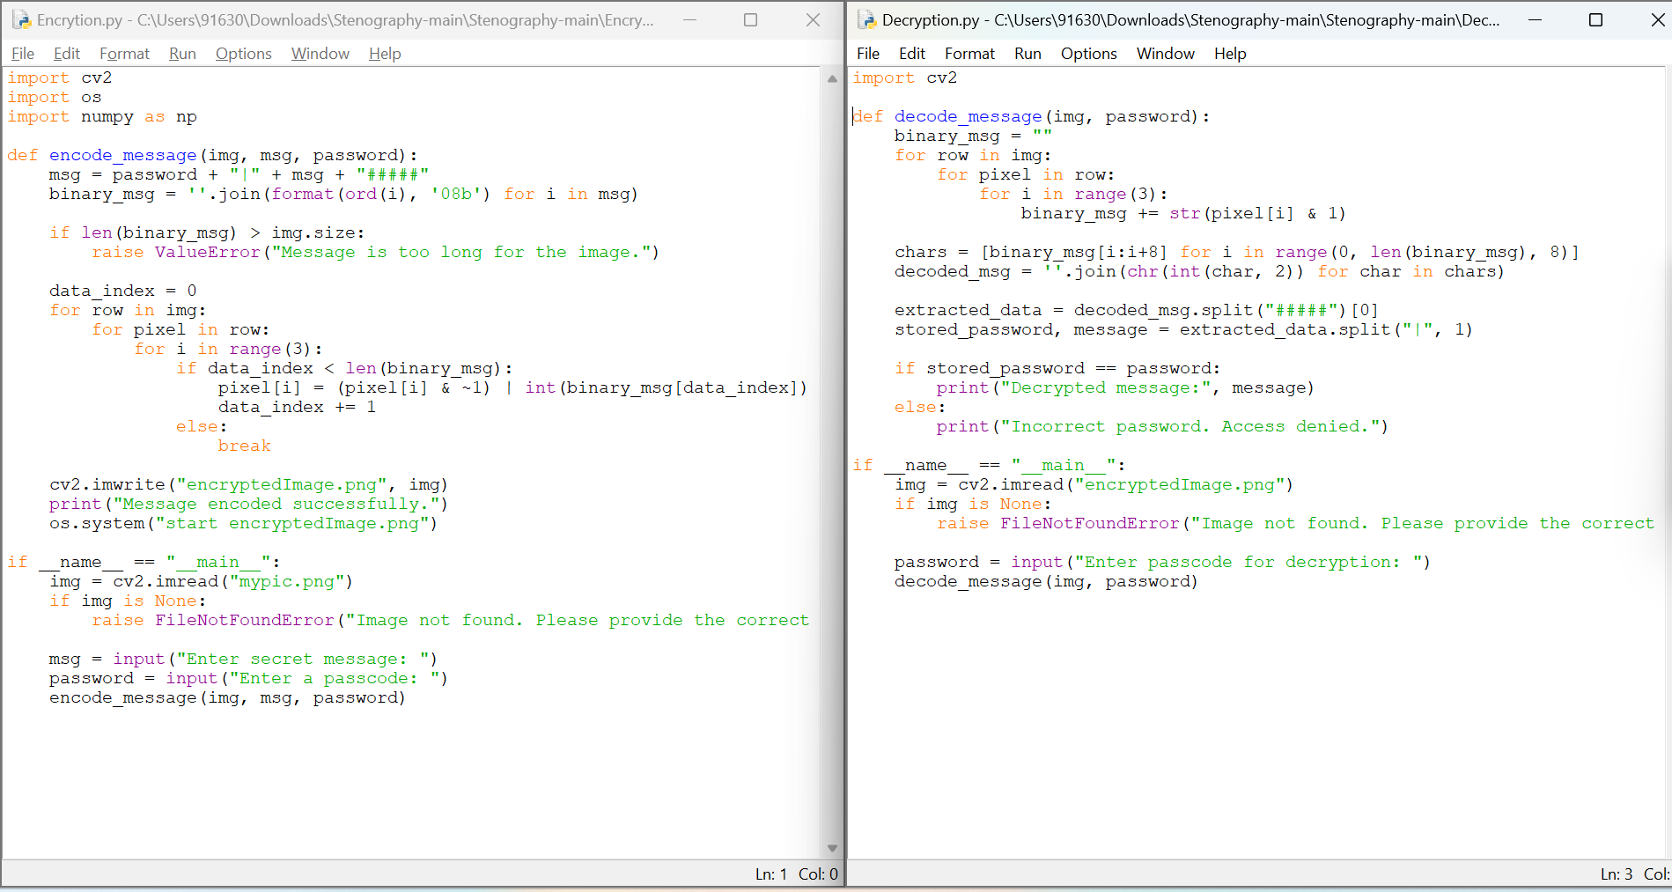
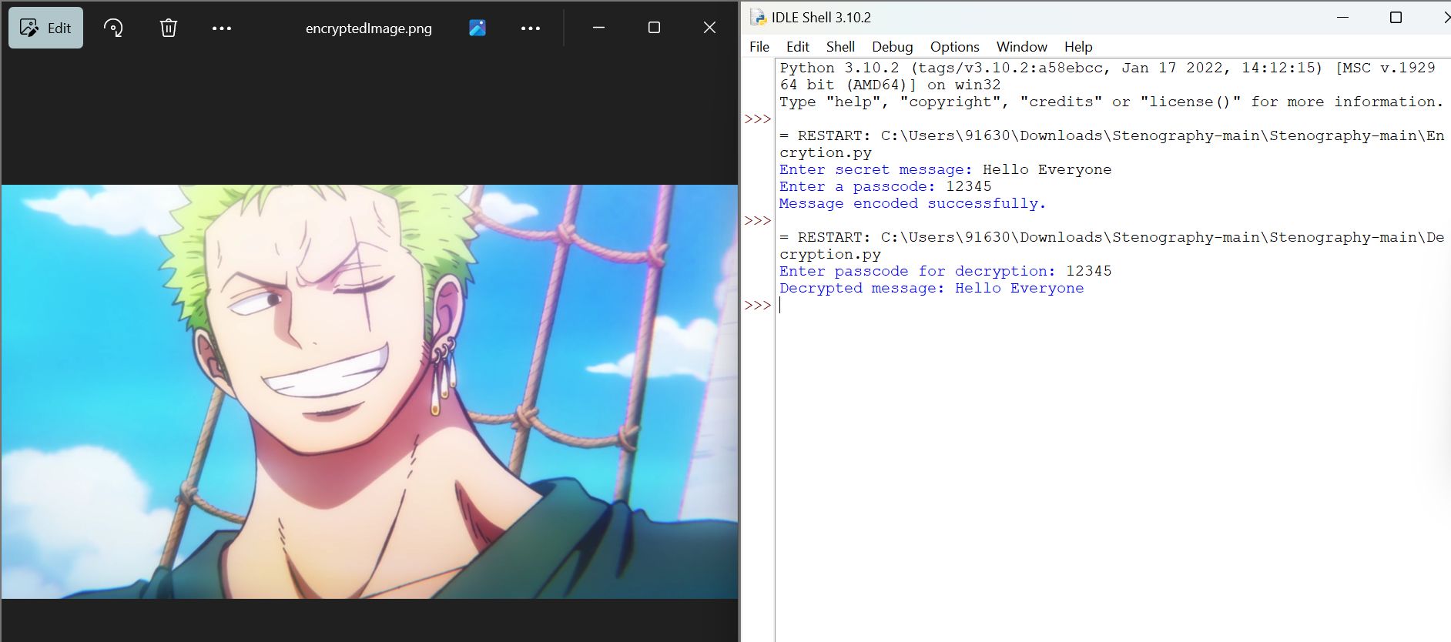
Results

Slide 8
Conclusion
In conclusion, this project successfully addresses the challenges of secure data hiding in images through advanced steganographic techniques. By improving upon traditional methods, it enhances security, embedding capacity, and imperceptibility while ensuring resistance to steganalysis attacks. The proposed approach provides a robust solution for covert communication, making it suitable for applications in cybersecurity, defense, finance, and personal data protection. By balancing security and efficiency, this project contributes to the advancement of modern steganography, offering a reliable and undetectable means of safeguarding sensitive information

Slide 9
GitHub Link
https://github.com/Indhureddie/AICTE-Cyber-Security-Internship.git

Slide 10
THANK YOU

